Slide 1
CSI3002-Applied Cryptography and Network Security
Faculty Name: Dr. A. Mary Mekala

Slide 2
Course Objectives
To learn the emerging concepts of cryptography and algorithms
To defend the security attacks on information systems using secure algorithms and Authentication process
To categorize and analyze the key concepts in network and wireless security

Slide 3
Course Outcomes
1. Infer the need of security to introduced strong cryptosystems.
2. Analyze the cryptographic algorithms for information security.
3. Identify the authentication schemes for membership authorization.
4. Identify computer and network security threats, classify the threats and develop a security model for detect and mitigate the attacks.
5. Identify the requirements for secure communication and challenges related to the secure web services
6. Identify the need of ethical and professional practices, risk management using emerging security solutions.

Slide 4
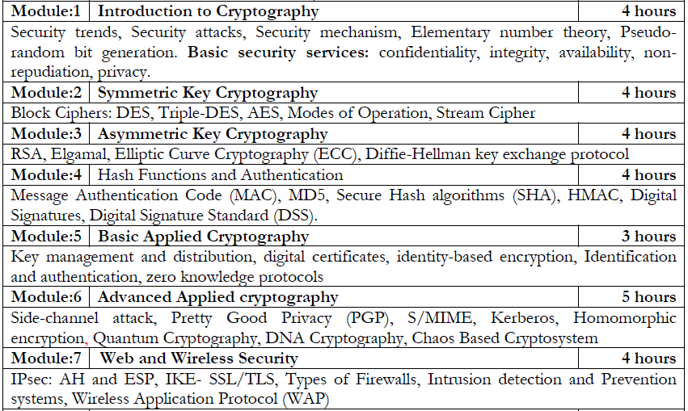

Slide 5
Introduction
Computer data often travels from one computer to another, leaving the safety of its protected physical surroundings. Once the data is out of hand, people with bad intention could modify or forge your data, either for amusement or for their own benefit.
Cryptography can reformat and transform our data, making it safer on its trip between computers.
The technology is based on the essentials of secret codes, augmented by modern mathematics that protects our data in powerful ways.
Network Security - measures to protect data during their transmission.
Internet Security - measures to protect data during their transmission over a collection of interconnected networks

Slide 9


Slide 10
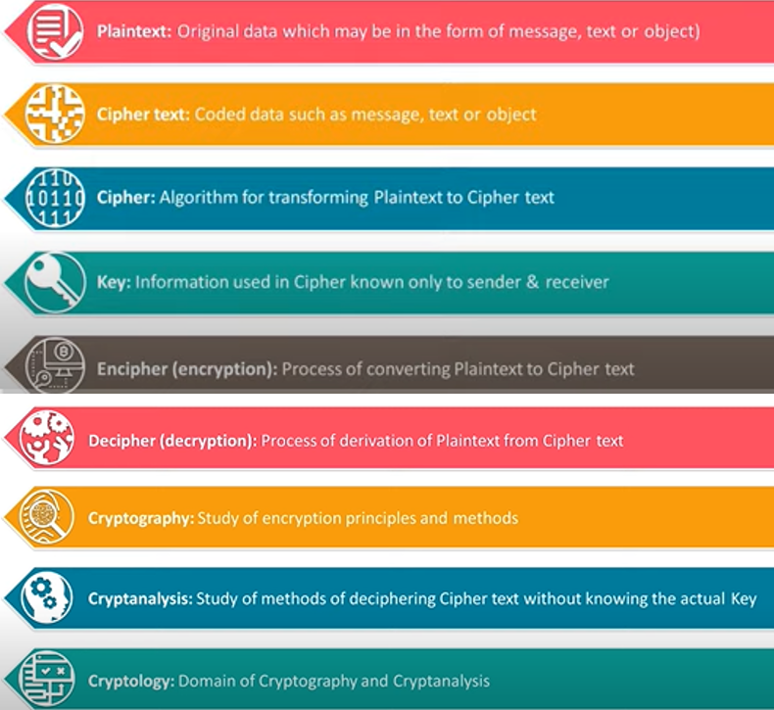
Key Terms

Slide 11
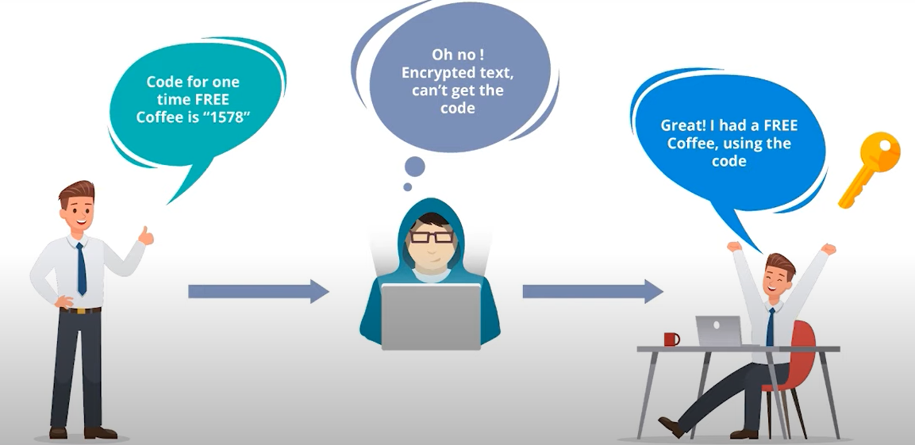
Cryptography

Slide 12
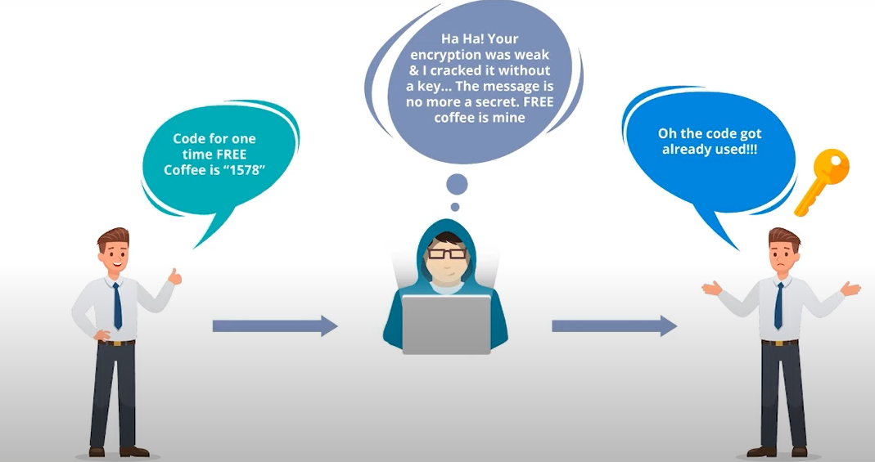
Cryptanalysis

Slide 13
Cryptography is everywhere
Secure communication:
web traffic: HTTPS
wireless traffic: 802.11i WPA2 (and WEP), GSM, Bluetooth
Encrypting files on disk: EFS, TrueCrypt
Content protection (e.g. DVD, Blu-ray): CSS, AACS
User authentication
… and much much more

Slide 14
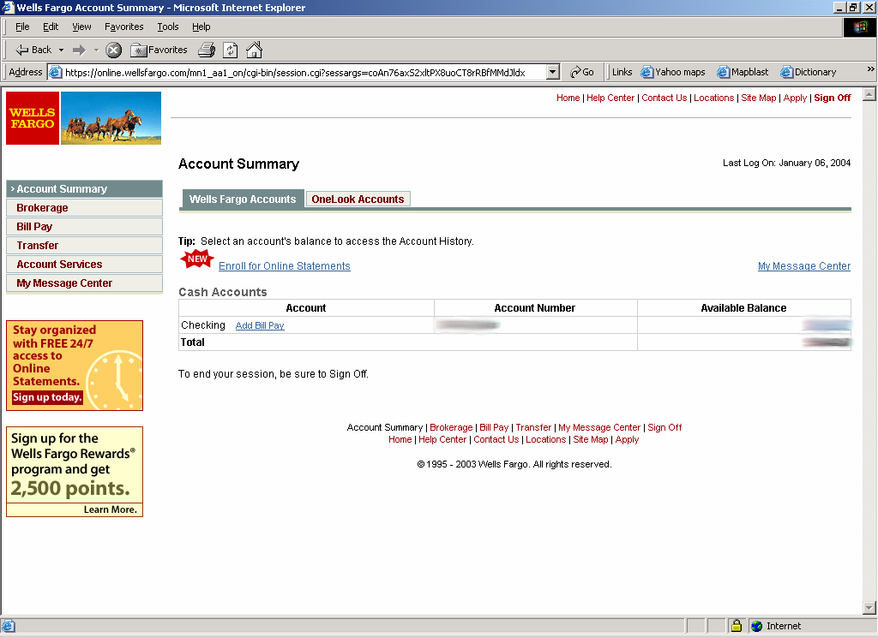
Secure communication
no eavesdropping
no tampering

Slide 15
Secure Sockets Layer / TLS
Two main parts
Handshake Protocol: Establish shared secret key using public-key cryptography
Record Layer: Transmit data using shared secret key
Ensure confidentiality and integrity

